Slide 1
Agile Development Tutorial Group 2 Role: Manufacturer

Slide 2
Data interface layout data dictionary

Slide 3
Manufacturers to Logistics
order_no | Char(10)
retailer_id | Char(10)
logistics_id | Char(10)
Ship_date | datetime()
weight | Double(7,5)

Slide 4
Retailers to Manufacturers
item_id | char(10)
quantity | int(10)
item_price | double(7.2)
retailer_id | char(10)
expected_date | datetime()
manu_id | char(10)

Slide 5
Responsibilities between Manufacturer & Logistics
Provide order number to the logistics company
Calculate the total weight of the products
Provide ship date to the logistics company
Provide retail ID to determine the retail locations
Provide logistics ID to determine different logistics company

Slide 6
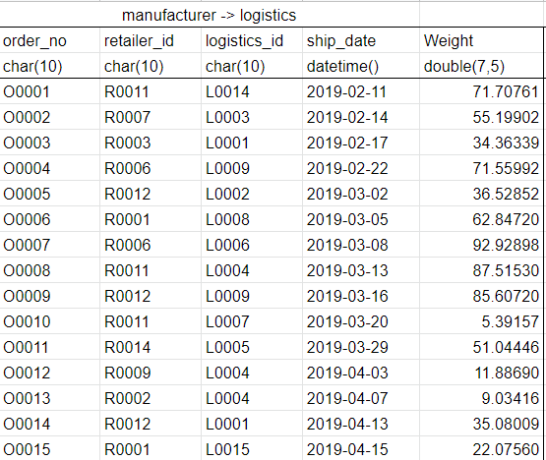

Manufacturer to Logistics Sample Data

Slide 7
Responsibilities between Retailer to Manufacturer
Receiving order from retailer
Assemble the products
Manufacture the products before the retailers expected date

Slide 8

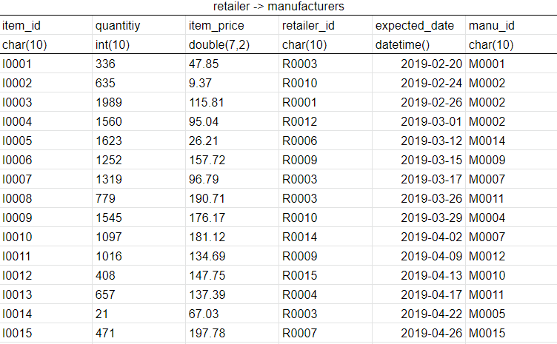

Retailer to Manufacturer Sample Data

Slide 9
End of Presentation

